Slide 1
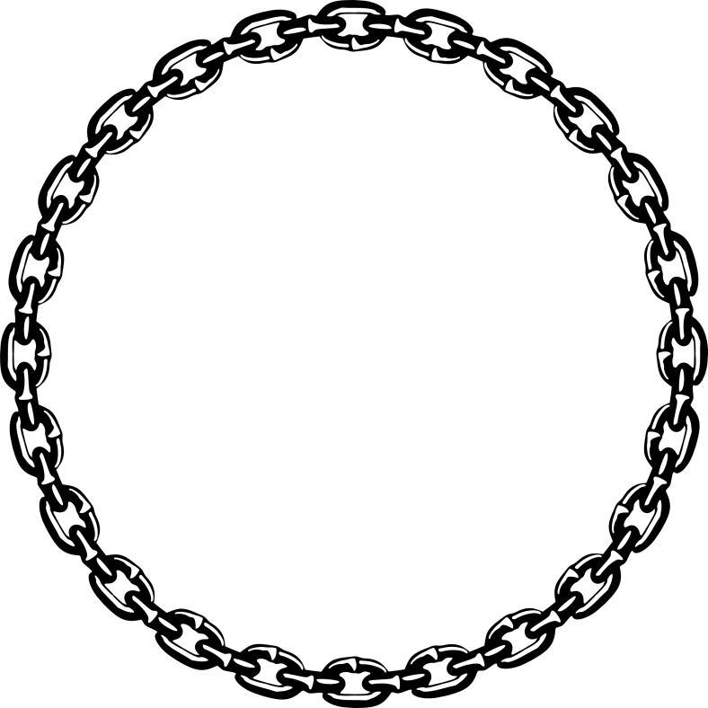
construction
Notes:
Hello Ney York!! Where are we? (Answers.)
Yes, New York but, specifically, in a building named Littl star, and technically on #rd floor ‘Slab’
People are living with lots of things like cell phone, wifi, medical service, donation and mobility......but have in mind that human being should be in space like here in the office working, in a lodge living, in a subway station commuting, and sometimes ski-resort taking rests. These are all products of construction industry, which I want to change with Blockchain Technology.

Slide 2
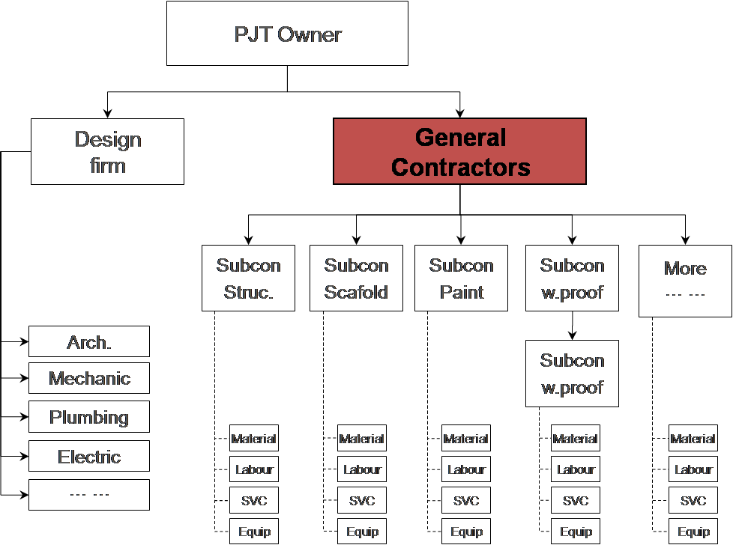
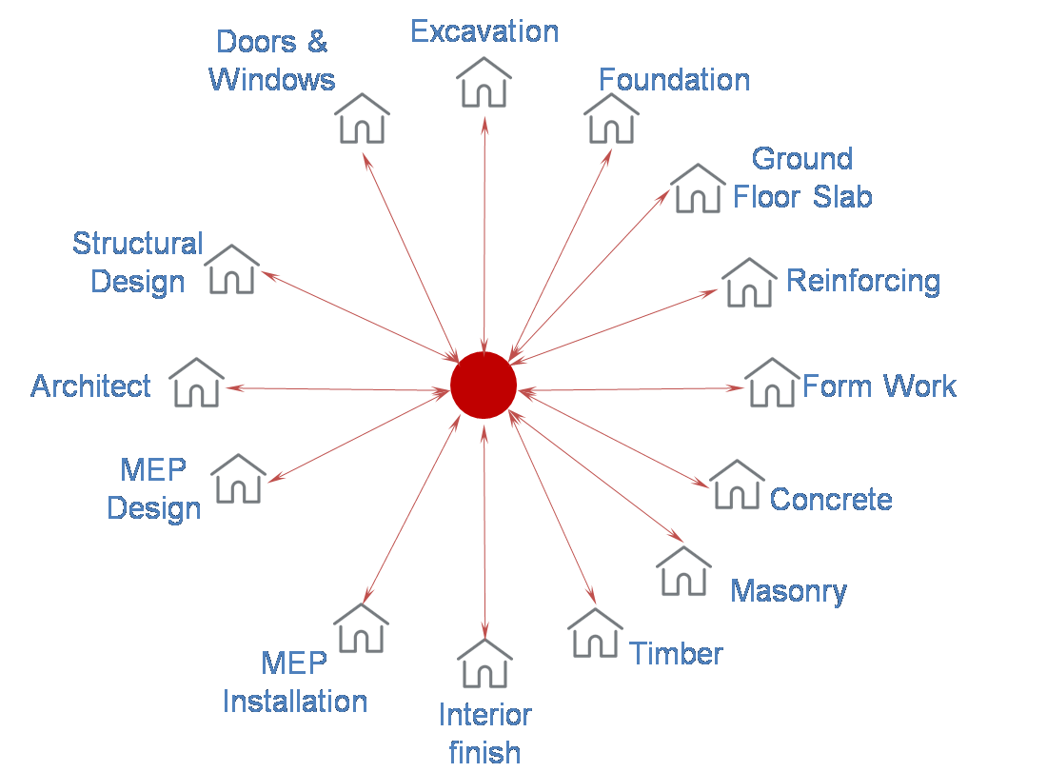
Problem > Background
Centralization decision making structure &
subcontract based industry
Industrialization
Centralization
Notes:
Construction industry has started from the beginning of human being. Because of that, it is highly industrialized on the basis of subcontracting and strongly centralized on specific player, general contractors. These are creating detailed problems.

Slide 3
Problem #1 > Unfair Trade
Unfair trade due to unbalance of
Contract, Application and Payment information
PJT
Owner
Contract #1
Unfair Trade happens
When Quantity of contract is not same
If same, but when application done by subcon could be more than contract
And then subcon asks GC to pay more for more application, but ... ...
When PJT owner pay GC but GC does not pay to Subcon
General
Contractor
≠
Contract #2
Sub_Con 1
≠
Contract #3
Sub_Con 2
Material
Labour
Contract
Application
Payment
Services
Equipment
Notes:
Contract #1~3 are different from contract, application and payment point of view. Why are they are different doing same scope of doing? When accurate quantity, the precise position of the application, execution of the upper contract is improperly shared, unfair trade happens making Players located at the lower end of the value chain will have more risk.

Slide 4
Problem #2 > Disproportion
Disproportion between work and profit,
because of centralized player’s late decision making
Architect
Structural
Engineer
Issue & Suggestion
Reinforcing
Waiting for
Decision
G.C
Low
Productivity
Decision
making
Form Work
Information
& suggestion
Less Profit
MEP Installation
MEP Design
Notes:
We anticipate related issues before delivering rebar, inform GC and request a decision. They communicate these issues to the structural engineer and then ask the associated sub_contractors for information and comments. After the final decision, the result is reported very late to us. We forecast and inform issues and deliver products to site creating the invisible value. However, productivity is lowered and Profit is also lowered.

Slide 5
Introduction > Daehan Steel
A steel manufacturing company
with credit, biz volume/size and constant innovation
2005
Listed on Korean Stock Exchange
9
hundred million USD of sales as of 2017
3
rd biggest rebar manufacturing company
1
st mover to change and innovate industry
Notes:
In South Korea, there is a company, named Daehan Steel, manufacturing and selling steel products and services in construction industry to solve these problems. On 2005, it is listed on Korean Stock Exchange, selling 900 hundred million US Dollar sales value as of 20017, 3rd biggest and always 1st mover in rebar industry.
Its business trajectory is very interesting and meaningful. Here’s more.

Slide 6
Introduction > Daehan Steel
Notes:
Trying to solve these problem, Daehan finally has 2 assets and 1 experience.

Slide 7
Assets #1 > Biz Expansion
From manufacturing as a core
Horizontal and Vertical Expansion
BIM
PJT
Planning
Design
Construction
Operation
Maintenance
Manufacturing
Asset Management
Processing
Delivery
Engineering
Notes:
First of all, it expands business domain not only horizontally but also vertically from manufacturing as a core including BIM, building information modeling.

Slide 8
Assets #2 > Global Stage
Geographical expanded to be onto
Global stage to USA, Vietnam and Singapore
UK
Russia
Canada
Euro Zone
China
Iraq
US
Kuwait
Japan
Philippines
Guam
Hongkong
STAZ USA
Malaysia
Australia
STAZ Vietnam
Singapore Branch
Notes:
It is doing exporting products BIC and has premises all over the global.

Slide 9
Experience > BIM
BIM based Production Management system
sharing information, but ... ... ...
Daehan’s Premise
BIM model API S/W
Integrate
Production System
with Trimble S/W
PJT
BIM
Production Information
Notes:
We have been doing with BIM technology. We integrate Daehan’s production management system with TIMBLE's Tekla BIM tool so that we are able to extract production information from TEKLA's BIM model and directly make production order for Daehan Steel, for all individual PJT and to share production information with players. And we also develop BIM model making S/W for players to make 3D model even more easily and faster. But it is not as widely accepted by industry as we have planned.

Slide 10
Solution >
Real World
Reward
Digital World
Digital Twin
Business
Platform for Work Place
Customer
Blockchain
Information
Platform for Decision Making
Exchange
Issue
Fiat
Money
Exchange
Notes:
BIM, Digital Twin is best for a work place, but when it comes to information sharing and decision-making, we need another one, BlockChain-based platform is strongly needed. It is ideal to raise issues on Blockchain and to simulate alternatives with Digital twin. Participants will be involved in creating a digital twin, giving their expertise, or sharing their own on-site information.

Slide 11
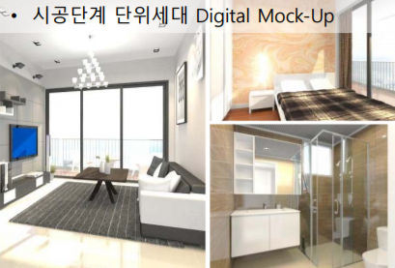
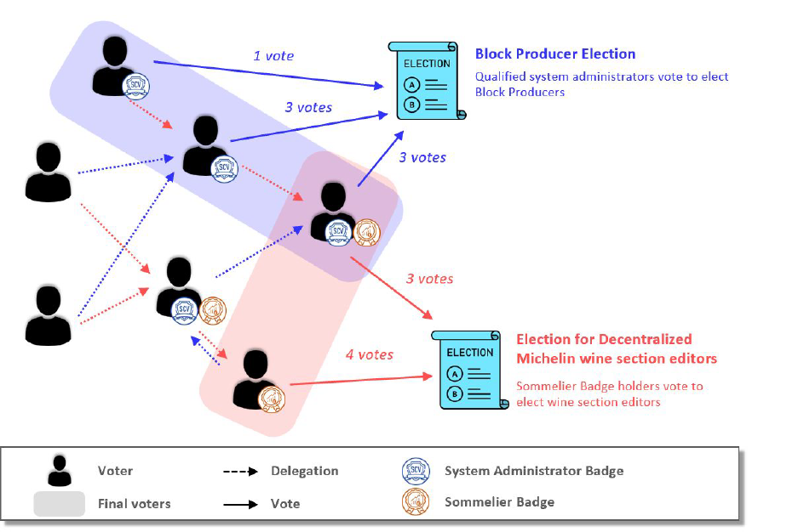
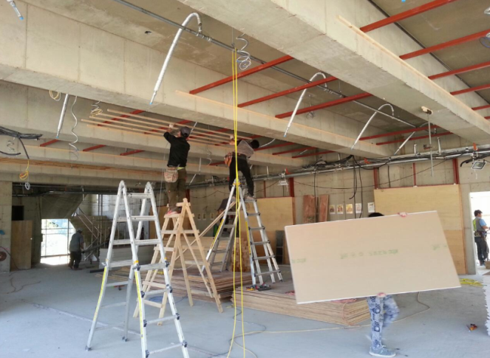
Solution > How it works
Digital Twin
Issue #3
Where these rebar is exactly applied?
and Quantity?
Alternatives
Cost of Finals
of Living Room?
Dose the rebar meet quality standard?
Simulation
Issue raising on Blockchain
Decision #1
Reinforcing Bar
Applied in Real World
Decision &
Smartcontract
Decision #2
Safety Issue
(Traditional Business)
Images from CAN foundation
Notes:
이를 해결하는 solution은
먼저 bulletin 혹은 dAPP을 통해서 issue 및 subject 를 raising 함
Digital Twin 을 통해서 합리적인 대안을 만들어 냄
dAPP 을 통한 decision making 을 진행하며, delegate system을 적용하며, CAN foundation의 system 일부를 사용하고 지원 받음
Apply to real world and feeback to raise new ones so that real world keeps better

Slide 12
Values >
From Sub_Contractors to Onwers
and Gene_Con cost down
Gene_Con
less management cost
User #1
Subway user
User #2_Tourist
USER Group
Proper usage of building
User #3
Tab water user
User #4
Sewerage user
Subway
Services
User #5
Highway User
SVC Provider
provides SVC as users want
User #6
Tenant
Water
Services
Road
Services
Owner #1
Lodge
Owner Group
has exactly same property as planned
No over budget
Sub_Con Group
Proper profit
No overwork and rework
by having balanced information of application etc
Owner #2
Office
Sub Con #2
Concrete
Owner#3
Asset management Corp.
Sub Con #1
Reinforcing

Slide 13
Market Forecast
Daehan’s captive market of 791m as SOM &
if just 1% of value as TAM, 1B+
etc
71m
31m
Value of
Construction Completed
Billet
BIC
107m
(TAM)
111.8b
1%
Processed
Bar
1B +
410m
(SOM)
(2017, Statistics Korea)
791m
Rebar
381m
Market
Sales of 2017
(USD )
(currency: 1,236 Won/$)
Notes:
Daehan’s annual sales volume is 900 million US Dollar value from 5 departments. Among them, processed bar and rebar’s amount, about 800 million, is Short Obtainable Market.
Let me share another interesting one. Value of construction Completed as of 2017 of in Korea is 111.8 billion US dollar, it’s from Stat. Korea, one of government agencies.
If 3% of it could be on this platform, Total Available Market is more than 3 thousand million.
It’s just suggestion, but 111.8 billion is big number and 3% is small proportion.

Slide 14
Requirement > Collaboration
Target industry
New Technology
Idea
Captive Market
Experience
Expertise
Credit
and so on
Business Opportunity
Technology
Frameworks
Trust
Notes:
We definitely have a goal and target industry. Futhermore we have assets like ideas, captive markets, experiences, expertise, and credibility in the industry. However, in order to make new business opportunities more profitable and visible, we have to work with the gurus of blockchain technology. I would like to cooperate with those have their frameworks, trust as well as technology itself and help eachothers.

Slide 15
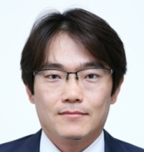
Requirement >
Partners & Investors
S/W and Business developers
Investor Group
Advisory Group
LECLE
··· ···
··· ···
Planning & White Paper
S/W Development
Business Development
Konkuk University (Droped)
MA, Real Estate
Seoul National University
BA, Architectural Engineering
BIM Manager (BCA, Singapore)
John1
John2
Searching and ... ...
Searching and ... ...
Notes:
Besides Daehan Steel and The Ventures, C2B_Chain are looking for additional investors and also for a partner to help us in the Advisory group. At the company level we are also looking for suitable experts for S / W development and business development. Planning and White Paper will be executed by myself.

Slide 16
Jongmin Jin
Founder of C2B_Chain
Mobile: +82 10-2762-5612
E-mail: jongmin.jin@gmail.com
WhatsApp & Skype : C2B_Chain
If you want to go fast, you should go alone.
But if you want to go far, you should go together.
Notes:
Daehan Steel has been leading innovation and change in the industry for about 60 years. And for next another 60 years, C2B_Chain, son company, will drive innovation and change. We want to go farther rather than to go faster, that’s why we need partners.
And more, Mr.Oh, the CEO of Daehansteel, who leads all the businesses, is here, so you can have a chance to meet him today to discuss more. Company brochure and name card available. Feel free to contact, through mobile, E-mail, and Social Network Services.

Slide 17
Milestones
Fund raising target on 2Q, 2019
Setup / Partnering / Token Economy ongoing
Here
2018
2019
2020
4Q
1Q
2Q
3Q
4Q
1Q
SetUp
Partnering
3+ Demo development
on CAN network
Proof of Concept
Token Economy
S/W development
White Paper
Notes:
At the moment, Construction to Blockchain is currently undergoing foundation, governance and partnering. We are also preparing the most important element, Token Economy, at an early stage. As the construction industry is conservative, three more demos development and proof of concept are planned to be done from 4Q, 2018 to 3Q,2019. And then Coin Offering will be on 4Q of 2019 after completion of what is needed.

